Slide 1
Network II- Network Roadmap
Lectured by: Thayheng Nhem

Slide 2
Review – What is Computer Network?
Definition: A Computer Network is defined as the interconnection of two or more computers. It is done to enable the computers to communicate and share available resource.
Application:
Sharing of Resource such as printer
Communication from one computer to another or from one system to another
Sharing of Information over geographically wide areas.

Slide 3
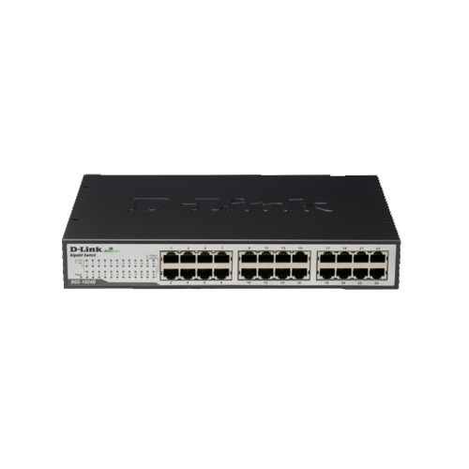
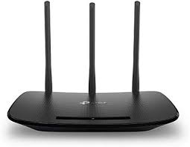
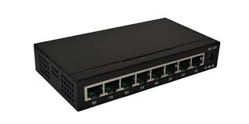
Review – What are these network devices?
Switch
Router
Hub

Slide 4
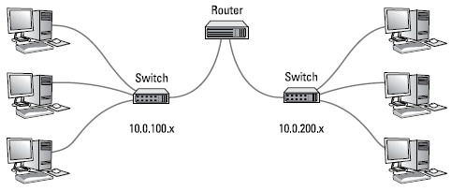
Review – What is Network Protocol and Standard?
Protocols and standards make networks work together. Protocols make it possible for the various components of a network to communicate with each other, and standards make it possible for different manufacturers’ network components to work together.

Slide 5
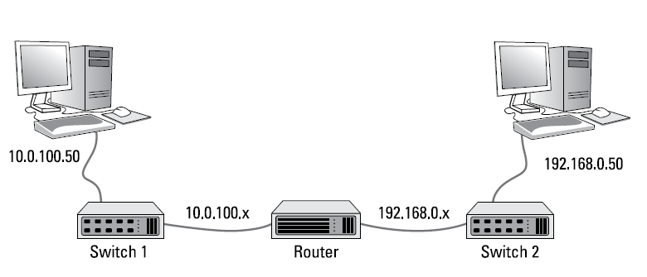
Review - What is IP Address?
An IP address is a number that uniquely identifies every host on an IP network. IP addresses operate at the network layer of the TCP/IP protocol stack, so they are independent of lower-level data link layer MAC addresses, such as Ethernet MAC addresses.

Slide 6
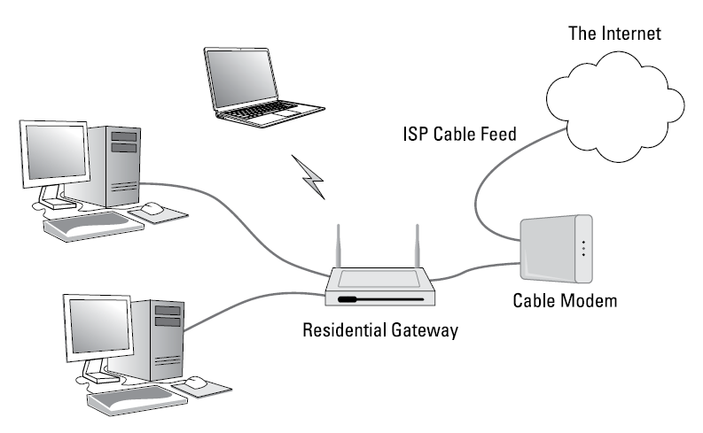
Review – What is routing?
Routing is the general term that describes what routers do. In short, when a router receives a packet from one network that is destined for a device on another network, the router determines the best way to get the packet to its destination.

Slide 7
Planning Network
A network can be defined as the grouping of hardware devices and software components which are necessary to connect devices within the organization, and to connect the organization to other organizations and the Internet.
Network Planning is having a fool-proof network infrastructure in hand with every little details is determined and identified.

Slide 8
Implementing Network
After you plan your network, then comes the fun of actually putting everything
together. Some of the important details such as installing network hardware, including cables and switches, as well as professional touches like patch panels and cable management. More to be considered.

Slide 9
Managing Network
Managing Network mean to administer networks, which means that they take care of the tasks of installing, configuring, expanding, protecting, upgrading, tuning, and repairing the network.
Network administrators take care of the network hardware, such as cables, hubs, switches, routers, servers, and clients, as well as network software, such as network operating systems, email servers, backup software, database servers, and application software.
Most importantly, network administrators take care of network users by answering their questions, listening to their troubles, and solving their problems.

Slide 10
Network Security
Network security in its simplest term, it is a set of rules and configurations designed to protect the integrity, confidentiality and accessibility of computer networks and data using both software and hardware technologies.
Every organization, regardless of size, industry or infrastructure, requires a degree of network security solutions in place to protect it from the ever-growing landscape of cyber threats in the wild today.

Slide 11
THE END

